Slide 1
The System Unit: Processing and Memory
K.N.Toosi
Fall 2022

Slide 2
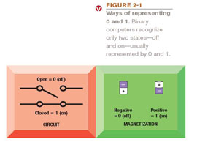
Data and Program Representation
In order to be understood by a computer, data and programs need to be represented appropriately
Digital computers: Can only understand two states, off and on (0 and 1)
Coding systems: Used to represent data and programs in a manner understood by the computer
Digital data representation: The process of representing data in digital form so it can be understood by a computer.

Slide 3
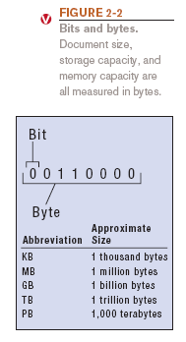
Digital Data Representation
Bit (binary digit): The smallest unit of data that a binary computer can recognize (a single 1 or 0)
Byte = 8 bits
Byte terminology used to express the size of documents and other files, programs, etc.
Prefixes are often used to express larger quantities of bytes: kilobyte (KB), megabyte (MB), gigabyte (GB), terabyte (TB), etc.

Slide 4
The Binary Numbering System
Numbering system: A way of representing numbers
Decimal numbering system
Uses 10 symbols (0-9)
Binary numbering system
Uses only two symbols (1 and 0) to represent all possible numbers
In both systems, the position of the digits determines the power to which the base number (such as 10 or 2) is raised

Slide 5
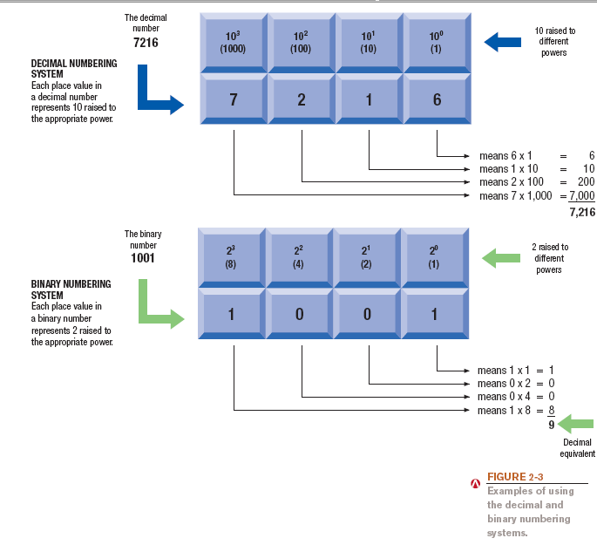
The Binary Numbering System

Slide 6
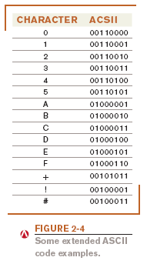
Coding Systems for Text-Based Data
ASCII and EBCDIC
ASCII (American Standard Code for Information Interchange): coding system traditionally used with personal computers
EBCDIC (Extended Binary-Coded Decimal Interchange Code): developed by IBM, primarily for mainframe use

Slide 7
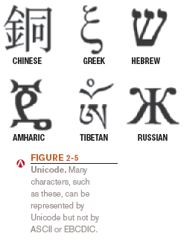
Coding Systems for Text-Based Data
Unicode: newer code (32 bits per character is common); universal coding standard designed to represent text-based data written in any ancient or modern language
Replacing ASCII as the primary text-coding system

Slide 8
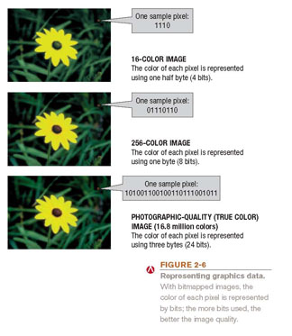
Coding Systems for Other Types of Data
Graphics (still images such as photos or drawings)
Bitmapped images: A variety of bit depths are possible (4, 8, 24 bits)
More bits = more colors

Slide 9
Coding Systems for Other Types of Data
Audio data: Must be in digital form in order to be stored on or processed by a computer
Often compressed when sent over the Internet
MP3 files
Video data: Displayed using a collection of frames, each frame contains a still image
Amount of data can be substantial, but can be compressed

Slide 10
Representing Programs: Machine Language
Machine language: Binary-based language for representing computer programs the computer can execute directly
Early programs were written in machine language.
Today’s programs still need to be translated into machine language in order to be understood by the computer
Most programs are written in other programming languages
Language translators are used to translate the programs into machine language

Slide 11
Inside the System Unit
System unit: The main case of a computer
Houses the processing hardware for a computer
Also contains storage devices, the power supply, and cooling fans
Houses the CPU, memory, interfaces to connect to peripheral devices (printers, etc), and other components such as CD/DVD drives
With a desktop computer, usually looks like a rectangular box

Slide 12
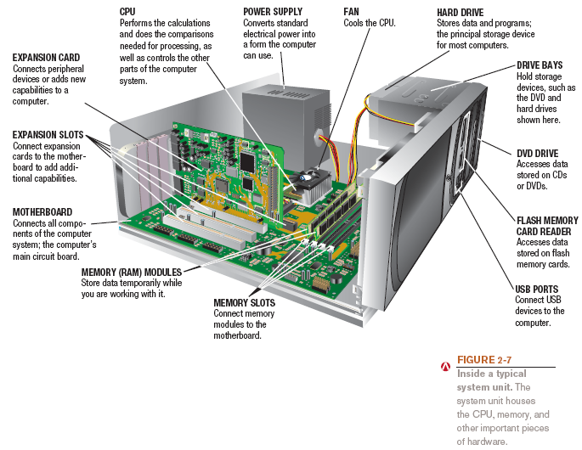
Inside the System Unit

Slide 13
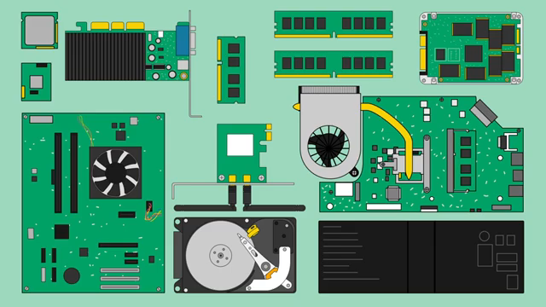
From: https://www.youtube.com/watch?v=HB4I2CgkcCo

Slide 14
The Motherboard
Computer chip: A very small pieces of silicon or other semi-conducting material onto which integrated circuits are embedded
Circuit board: A thin board containing computer chips and other electronic components
Motherboard or system board: The main circuit board inside the system unit
All devices must connect to the motherboard
External devices (monitors, keyboards, mice, printers) typically connect by plugging into a port exposed through the exterior of the system unit
Wireless devices connect through a transceiver or wireless networking technology (like Bluetooth)

Slide 15
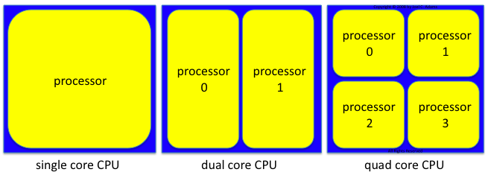
The CPU
Central processing unit (CPU): circuitry and components packaged together and connected directly to the motherboard
Does the vast majority of processing for a computer
Also called a processor; called a microprocessor when talking about personal computesr
Dual-core CPU: Contains the processing components (cores) of two separate processors on a single CPU
Quad-core CPU: Contains 4 cores
Typically different CPUs for desktop computers, portable computers, servers, mobile devices, consumer devices, etc.
Often made by Intel or AMD

Slide 16
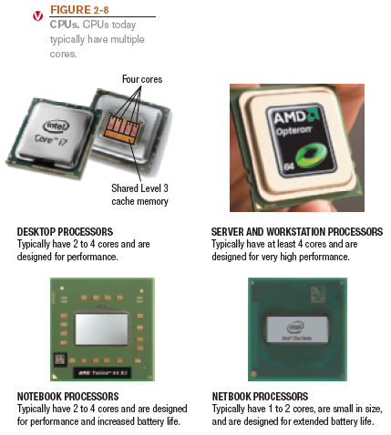
The CPU

Slide 17
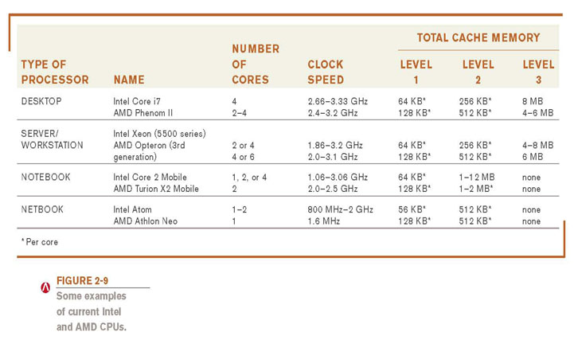
The CPU

Slide 18
Processing Speed
CPU clock speed: One measurement of processing speed
Measured in megahertz (MHz) or gigahertz (GHz)
Higher CPU clock speed = more instructions processed per second
Alternate measure of processing speed is the number of instructions a CPU can process per second
Megaflops, gigaflops, teraflops
Other factors (CPU architecture, memory, bus speed, amount of RAM, etc.) also affect the overall processing speed of a computer
Benchmark tests: Can be used to evaluate overall processing speed

Slide 19
Cache Memory
Cache memory: Special group of very fast memory chips located on or close to the CPU
Level 1 is fastest, then Level 2, then Level 3
More cache memory typically means faster processing
Usually internal cache (built into the CPU)
Often some cache dedicated to each core; may also have some shared cache accessible by any core

Slide 20
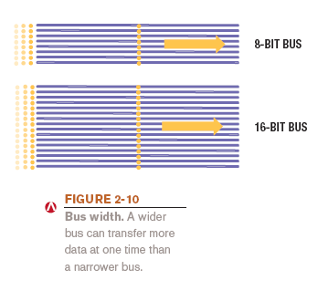
Bus Width, Bus Speed, and Bandwidth
Bus: An electronic path over which data can travel
Bus width: The number of wires in the bus over which data can travel
Bus width and speed determine the throughput (or bandwidth) of the bus
The amount of data that can be transferred by the bus in a given time period

Slide 21
Memory
Memory refers to chip based storage
RAM (random access memory): Computer’s main memory. Random-access memory is a form of computer memory that can be read and changed in any order, typically used to store working data and machine code
Stores essential parts of operating system, programs, and data the computer is currently using
Adequate RAM is needed to run programs
Volatile: Contents of RAM is lost when the computer is shut off
RAM is called "random access" because any storage location can be accessed directly. In contrast to memory on magnetic tape in which an item of data could only be accessed by starting from the beginning of the tape and finding an address sequentially.

Slide 22
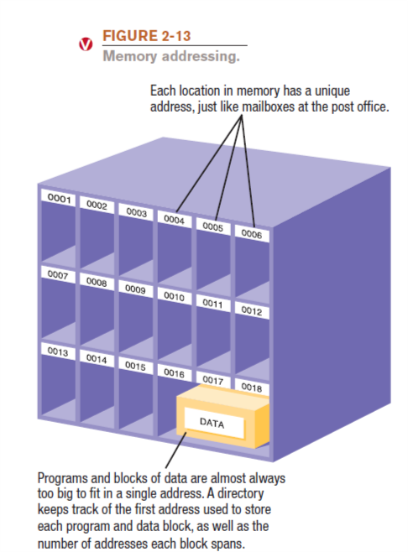
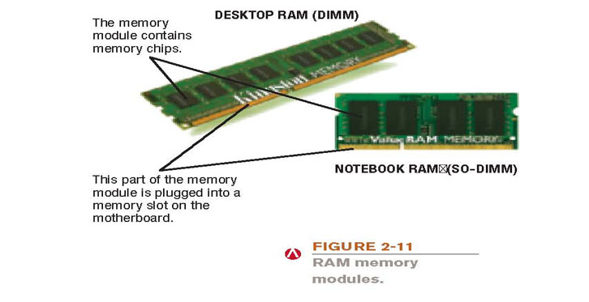
Memory

Slide 23
Memory
Registers: High-speed memory built into the CPU; used by the CPU
ROM (read-only memory): Non-volatile chips located on the motherboard into which data or programs have been permanently stored.
One of main duties of ROM is storing system information, such as a computer’s BIOS (basic input/output system), which is the sequence of instructions the computer follows during the boot process. For instance, one of the computer’s first activities when you turn on the power is to perform a poweron self-test or POST. The POST checks each component to see if it is functioning properly, and initializes system settings, which produces the beeps you may hear as your computer boots.
Flash memory consists of nonvolatile memory chips that can be used for storage by the computer or the user. Flash memory chips have begun to replace ROM. By storing this information in flash memory instead of ROM, the boot sequence can be updated as needed.

Slide 24
Fans and Other Cooling Components
Heat: A continuing problem for CPU and computer manufacturers
Fans: Used on most personal computers
Water cooling systems: Cool the computer with liquid-filed tubes
Notebook cooling stands

Slide 25
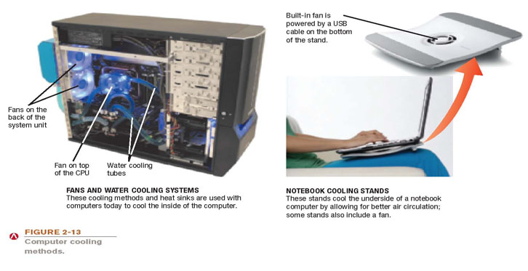
Fans, Heat Sinks, and Other Cooling Components

Slide 26
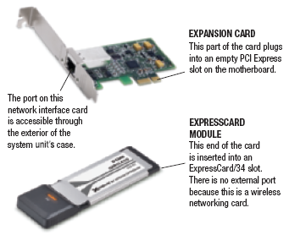
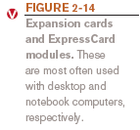
Expansion Slots, Expansion Cards, and ExpressCards
Expansion slot: A location on the motherboard into which expansion cards are inserted
Expansion card: A circuit board used to add additional functionality or to attach a peripheral device
ExpressCard modules: Designed for notebook computer expansion

Slide 27
Buses
Bus: An electronic path within a computer over which data travels
Expansion bus: Connects the CPU to peripheral (typically input and output) devices
Memory bus: connects CPU directly to RAM
Frontside bus: connects CPU to I/O bridge
PCI and PCI Express (PCIe) bus
Universal Serial Bus (USB)
FireWire/IEEE 1394 bus

Slide 28
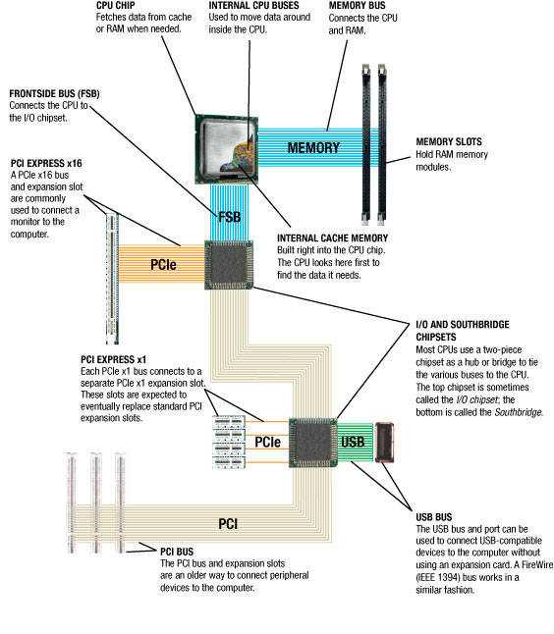
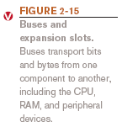
Buses

Slide 29
Ports and Connectors
Port: A connector on the exterior of a computer’s system unit to which a device may be attached
Monitor (VGA, DVI, HDMI)
Network
Modem
USB
FireWire
Keyboard
SCSI
MIDI
IrDA
Flash memory card slots
Game
Audio
eSATA

Slide 30
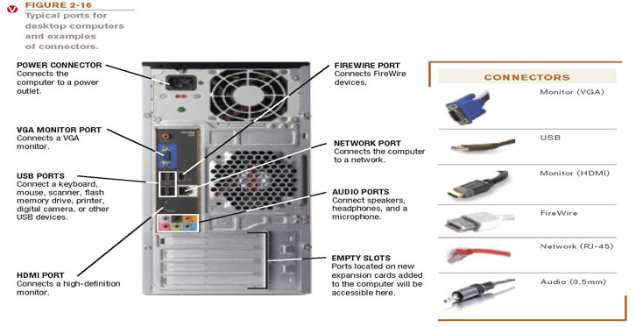
Ports and Connectors

Slide 31
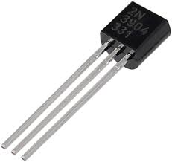
How the CPU Works
CPU: Consists of a variety of circuitry and components packaged together
Transistor: Key element of the microprocessor
Made of semi-conductor material that acts like a switch controlling the flow of electrons inside a chip
Today’s CPUs contain hundreds of millions of transistors; the number doubles about every 18 months (Moore’s Law)
Moore's law is the observation that the number of transistors in a dense integrated circuit (IC) doubles about every two years.

Slide 32
Typical CPU Components
Arithmetic/Logic Unit (ALU): Performs integer arithmetic and logical operations
Floating Point Unit (FPU): Performs decimal arithmetic
Control unit: Coordinates and controls activities
Prefetch unit: Tries to fetch data and instructions before they are needed from cache or RAM
Decode unit: Translates instructions so they are understood by the control unit, ALU, and FPU
Internal cache and registers: Store data and instructions needed by the CPU
Bus interface unit: Allows the core to communicate with other CPU components

Slide 33
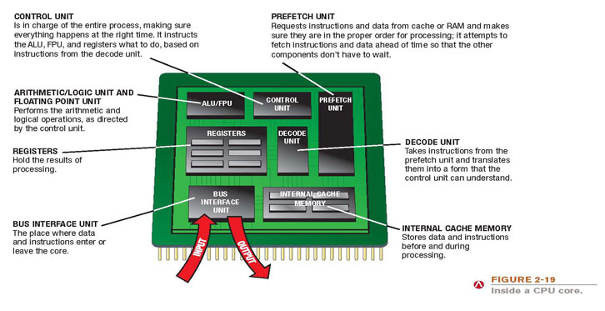
Typical CPU Components

Slide 34
The System Clock and the Machine Cycle
System clock: Timing mechanism within the computer system that synchronizes the computer’s operations
Each signal is a cycle
Number of cycles per second = hertz (Hz)
Many PC system clocks run at 200 MHz
Computers can run at a multiple or fraction of the system clock
For instance, with a CPU clock speed of 2 GHz, the CPU clock “ticks” 10 times during each system clock tick
During each CPU clock tick, one or more pieces of microcode are processed

Slide 35
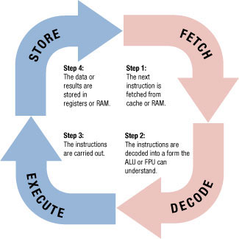
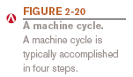
The System Clock and the Machine Cycle
Machine cycle: The series of operations involved in the execution of a single machine level instruction
Fetch: The program instruction is fetched
Decode: The instructions are decoded so the control unit, ALU, and FPU can understand them
Execute: The instructions are carried out
Store: The original data or the result from the ALU or FPU execution is stored in the CPU’s registers

Slide 36

From: https://www.youtube.com/watch?v=Z5JC9Ve1sfI&t=3s

Slide 37

From https://www.youtube.com/watch?v=xnyFYiK2rSY

